Slide 1


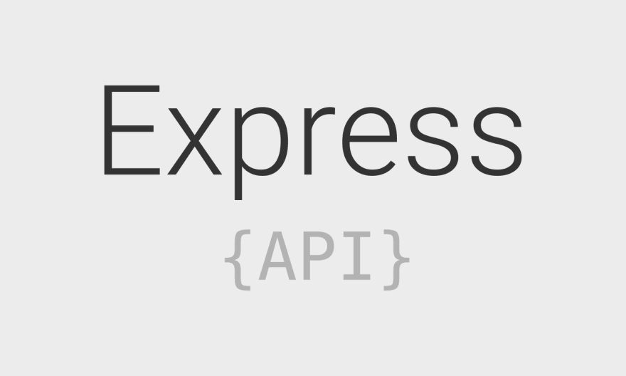
Is aws-serverless-express good or bad?
Notes:
Good morning API friends. Welcome to my presentation about Serverless APIs. I hope that by the end of it, we would have more serverless ninjas across the globe.

Slide 2
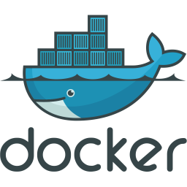
Notes:
Today we’re going to tackle the basics of serverless architecture, cool things that you can do with it and things that you guys need to be careful with when working with serverless technologies.

Slide 3

Host Environments
Notes:
Today we’re going to tackle the basics of serverless architecture, cool things that you can do with it and things that you guys need to be careful with when working with serverless technologies.

Slide 4
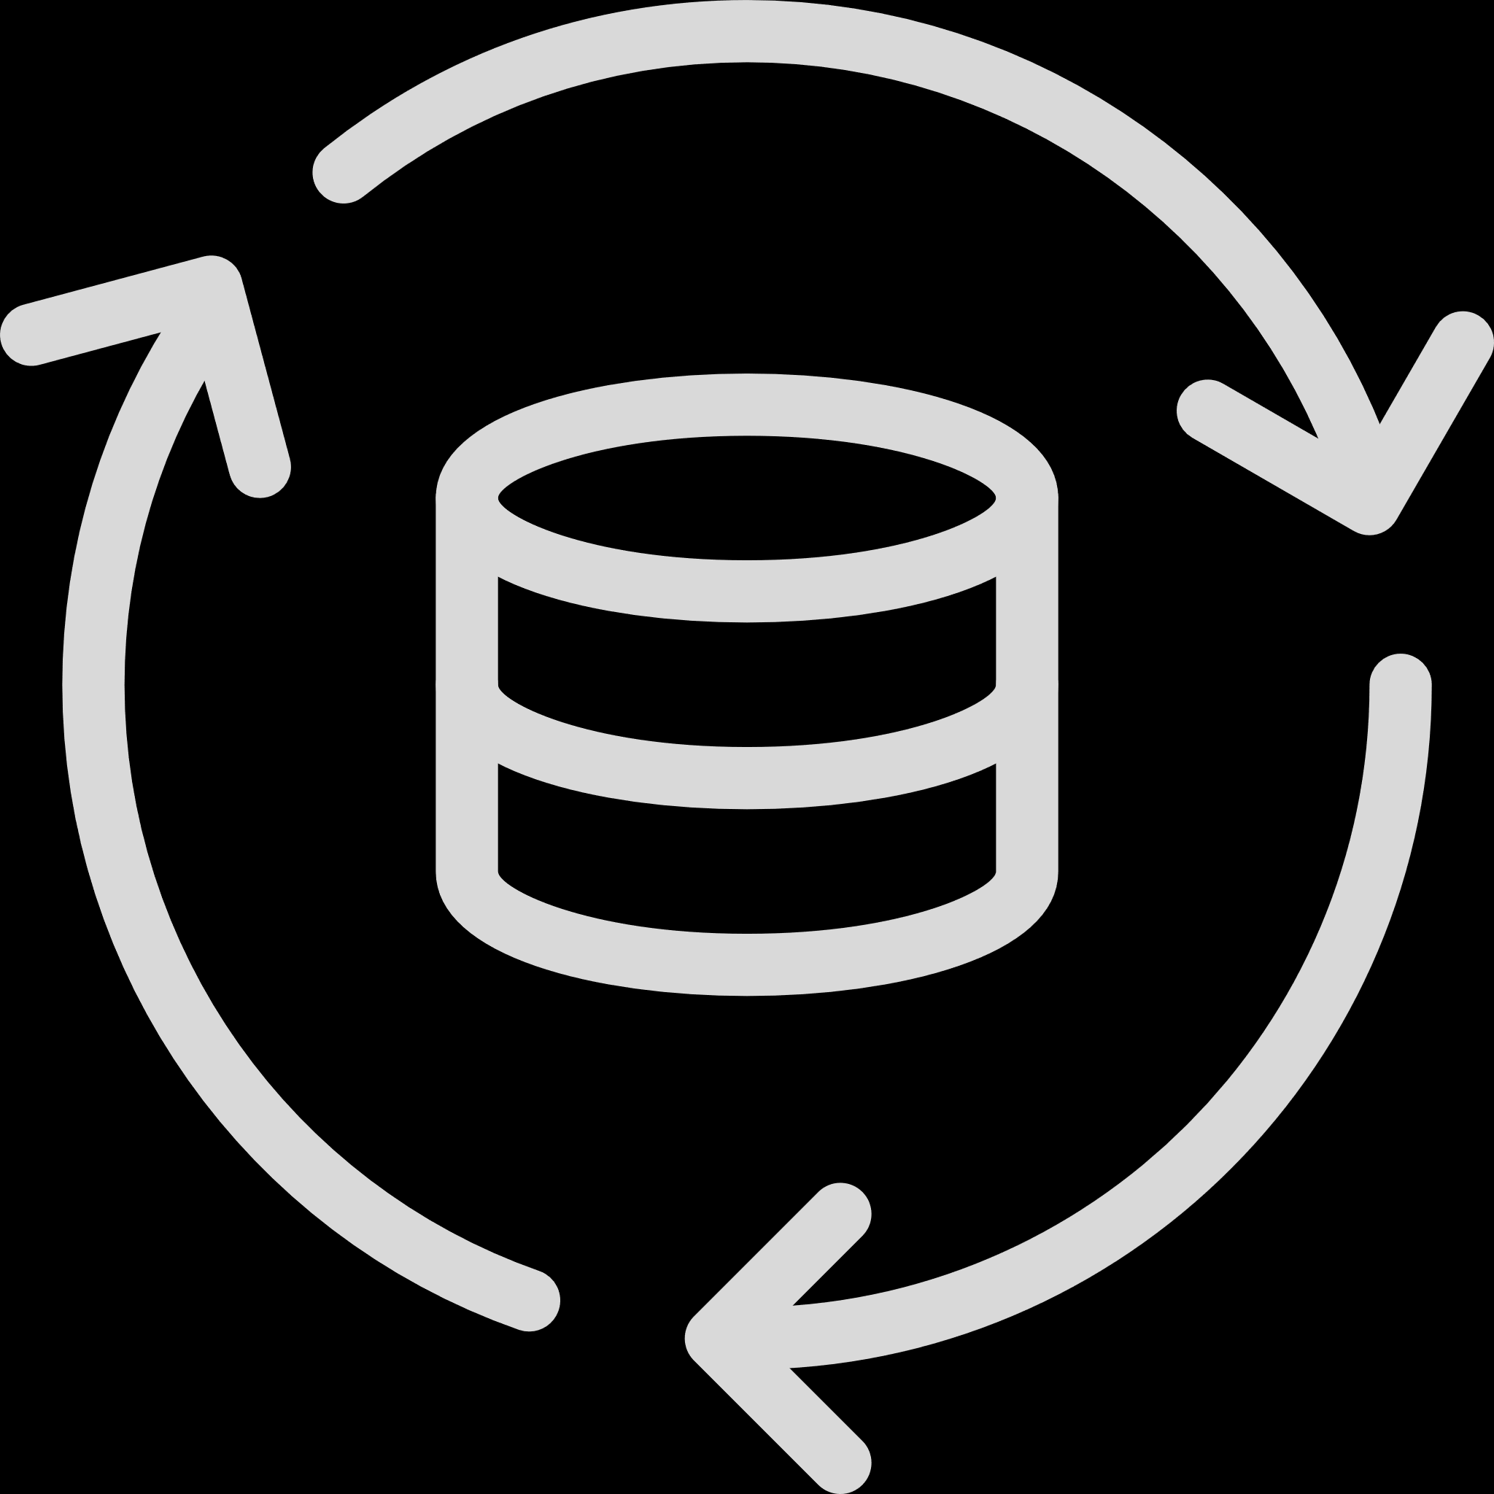
Application State
Notes:
Today we’re going to tackle the basics of serverless architecture, cool things that you can do with it and things that you guys need to be careful with when working with serverless technologies.

Slide 5

Comparison Matrix
Notes:
Today we’re going to tackle the basics of serverless architecture, cool things that you can do with it and things that you guys need to be careful with when working with serverless technologies.

Slide 6

Disadvantages
Notes:
Today we’re going to tackle the basics of serverless architecture, cool things that you can do with it and things that you guys need to be careful with when working with serverless technologies.

Slide 7

Verdict
Notes:
Today we’re going to tackle the basics of serverless architecture, cool things that you can do with it and things that you guys need to be careful with when working with serverless technologies.

